Slide 1

BLOCKCHAIN BASED ADAPTIVE TRUST MANAGEMENT IN INTERNET OF VEHICLES USING SMART CONTRACT DOMAIN: BLOCK CHAIN BATCH NO : 7
Guide : Mrs. Vijayalakshmi.C
presented by,
ArockiaSneha . A
Kaviya. B
Harini . S

Slide 2
INTRODUCTION
We are proposing a emergency message in VANET environment.
In this system messages are broadcasted only in their region of interest so that delivery latency will be decreased.
In Proposed system if a vehicle in the environment detects a dangerous event, it immediately generates and broadcasts emergency message to vehicles in region of interest, so that the vehicles can take preventive measures to avoid accident.
Emergency Messages will be broadcast to vehicles which are needed to take action to avoid accident.
And we proposed the security function for this project while message communication.
When the messages send to one user \to another user we should encode the content inside the message and compare the encoded values.
If the encoded values are same that user recognized the authorized user and they will get the trust vales, otherwise that user recognized as a unauthorized user they will get a minus trust values.

Slide 3
LITERATURE SURVEY
S.No | year | Author name Journal | Project title | Merits | Demerits
1 | 2015 | Samira Harrabi , Ines Ben Jaafar, Khaled Ghedira Macrothink Institute ISSN 1943-3581 | A Novel Clustering Algorithm Based on Agent Technology for VANET | Goal of VANET is to provide communications between nearby nodes or between nodes and fixed infrastructure. Various searches have been recently published deal with clustering for VANETs. But most of them are focused on minimizing network overhead value | The most proposed clustering algorithms for MANET are unsuitable for VANET. Number of created clusters and had not considered the vehicles interests which defined as any related data used to differentiate vehicle from another
2 | 2009 | Muaz Niazi and Amir Hussain IEEE Communications Magazine ( Volume: 47, Issue: 3, March 2009) | Agent-Based Tools for Modeling and Simulation of Self-Organization in Peer-to-Peer, Ad Hoc, and Other Complex Networks | Agent-based modeling and simulation tools provide a mature platform for development of complex simulations. Simulation of complex networks such as pervasive computing, large-scale peer-to-peer systems, and networks involving considerable environ | They however, have not been applied much in the domain of mainstream modeling and simulation of computer networks. To point out problems with the current simulation methodologies for telecommunications networks, such as the use of pseudo-random number generators.

Slide 4
3 | 2015 | Driss Abada, Abdellah Massaq International Journal of Computer Applications Volume-132 number-2 | Improving Relay Selection Scheme for Connecting VANET to Internet over IEEE 802.11p | Vehicular ad hoc networks (VANETs) enable vehicles to communicate with each other (V2V) as well as with roadside infrastructure units (V2I). Based only on mobility parameters, we can select longest life time routes to routing packet, but these routes may be with low quality of signal. | A high vehicular speed can cause frequent disconnection between nodes, the large number of vehicles on the road can flood the VANETs network by broadcasting messages which will increase overhead. Congested and more realistic environment scenario, when the number of vehicular sources increases, interference, noise and access channel contention increases as well.
4 | 2012 | Kayhan Zrar Ghafoor Kamalrulnizam Abu Bakar Springer article. Wireless Netw 19, 345–362 (2013) | Intelligent beaconless geographical forwarding for urban vehicular environments | A Vehicular Ad hoc Network is a type of wireless ad hoc network that facilitates ubiquitous connectivity between vehicles in the absence of fixed infrastructure. The simulation results show that the proposed protocol can improve average delay and successful packet delivery ratio in realistic wireless channel conditions and urban vehicular scenarios. | A key challenge to the successful deployment of vehicular communication is the implementation and efficiency of the medium access control (MAC) layer. One of the problems associated with many of the proposed vehicular MAC methods is the representativeness of the simulated vehicular scenarios, as evidenced by the works.

Slide 5
5 | 2016 | Kanika Grover, Alvin Lim Auburn university electronic theses and dissertations | Privacy-Enabled Probabilistic Verification in Broadcast Authentication for Vehicular Networks | Vehicular Ad hoc Networks (VANETs) authentication schemes need to consider mobility and rapidly changing topologies in addition to an unreliable wireless channel communication. We propose a practical and efficient strategy that makes use of secure ECDSA but still decreases the computation time for the most relevant packets. | It has the drawback of expensive computations for verification. We will implement and study IEEE 1609:2 on realistic VANETs and study the problem of long verification delay.
6 | 2013 | Kayhan Zrar Ghafoor and Marwan Aziz Mohammed Macrothink Institute ISSN 1943-3581 Volume 5,number 4 | Routing Protocols in Vehicular Ad hoc Networks: Survey and Research Challenges | A Vehicular Ad hoc Network (VANET) is a type of wireless ad hoc network that facilitates ubiquitous connectivity between vehicles in the absence of fixed infrastructure. We analyze the simulation results and discuss the strengths and weaknesses of these routing protocols in regard to their suitability to vehicular networks. | Multi-hop routing and beaconing approaches are two important research challenges in high mobility vehicular networks. We perform a comparative study among the existing routing solutions, which explores the main advantages and drawbacks behind their design.

Slide 6
7 | 2019 | Iván García-Magariño, Sandra Sendra, IEEE internet of things journal( Volume: 6, Issue: 4, Aug. 2019) | Security in vehicles with IoT by prioritization rules, vehicle certificates and trust management | The Internet of vehicles (IoV) provides new opportunities for the coordination of vehicles for enhancing safety and transportation performance. Vehicles can be coordinated for avoiding collisions by communicating their positions when near to each other | IoV also brings security challenges, such as keeping safe from virtual hijacking. Vehicles with IoT and autonomous decisions on motion imply many challenges for the viewpoint of security and safety, as one can observe in the variety of possible attacks over self-driving vehicles.
8 | 2018 | Talal Ashraf Butt, Razi Iqbal Publons journal, computer science and engineering in july,2018 | Social Internet of Vehicles: Architecture and Enabling Technologies | The key goal of Internet of Things (IoT) has been the provision of value-added services based on the ubiquitously available smart devices that can offer diverse services by interacting with each other. This cognizance enables these smart devices to socialize with each other based on shared context and mutual interests. | IoV is conceptualized to solve several problems faced in traditional VANETs, such as, lack of coordination between disparate vehicles that are travelling at a distance from each other, scalability, ubiquity and information insufficiency, etc. The sharing of information in SIoV depends on several factors such as context, connection type, network structure, nature of application and environment.

Slide 7
9 | 2017 | Kaveh Bakhsh Kelarestaghi, Mahsa Foruhandeh Arxiv Journal https://arxiv.org/abs/1903.01541 | Survey on Vehicular Ad Hoc Networks and Its Access Technologies Security Vulnerabilities and Countermeasures | Providing knowledge to the vehicles or other entities involved with modern transportation in such networks, is the key to proper traffic management, efficient use of resources, and to improve the transportation safety. Compounding VANETs and modern vehicles will allow adversaries to gain access to the invehicle networks and take control of vehicles remotely to use them as a target or a foothold. | We survey security challenges that emerge from application of different VANETs’ access technologies. Security challenges and propound heterogeneous technologies to achieve the highest security and best performance in VANETs.

Slide 8
PROBLEM STATEMENT
In any city mobility is a key concern; be it going to school, college and office or for any other purpose citizens use transport system to travel within the city.
With urbanization expanding with speedy stride, number of vehicles on road is also increasing. Combination of both in return puts enormous pressure on cities to maintain a better traffic system so that the city keeps on moving without any hassle.
Number of fatal accidents increases with increase in traffic flow. Delivering information about some dangerous conditions like forward collisions, backward collisions, overspeeding prior to the driver reduces the number of accidents.
The system delivers information like indicators and partial brakes accidents on roads, change in route, diversions, work zone conditions etc. that contributes a lot to reduce road accidents and therby ensuring the safety of road users.

Slide 9


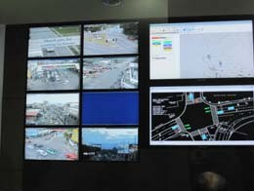





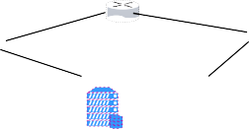



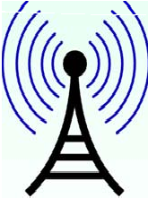
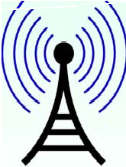




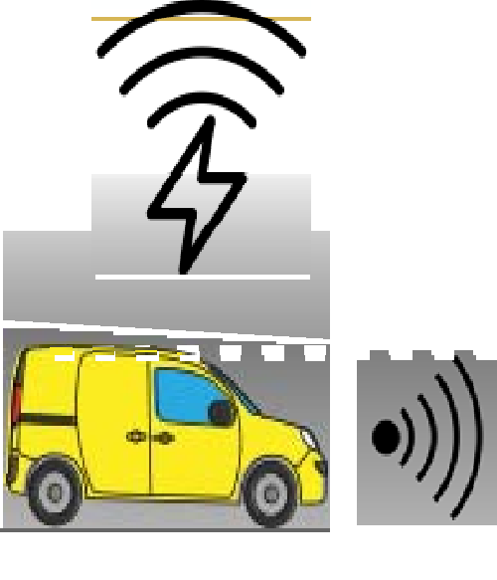
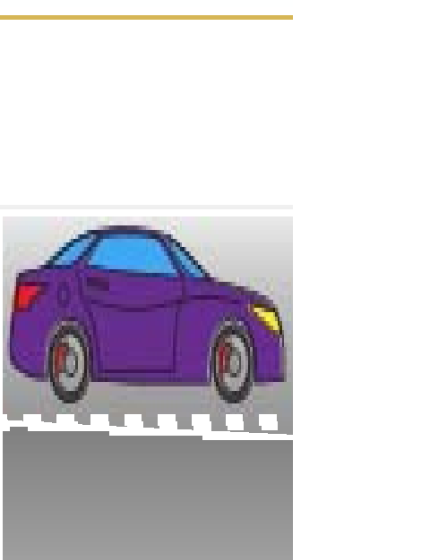
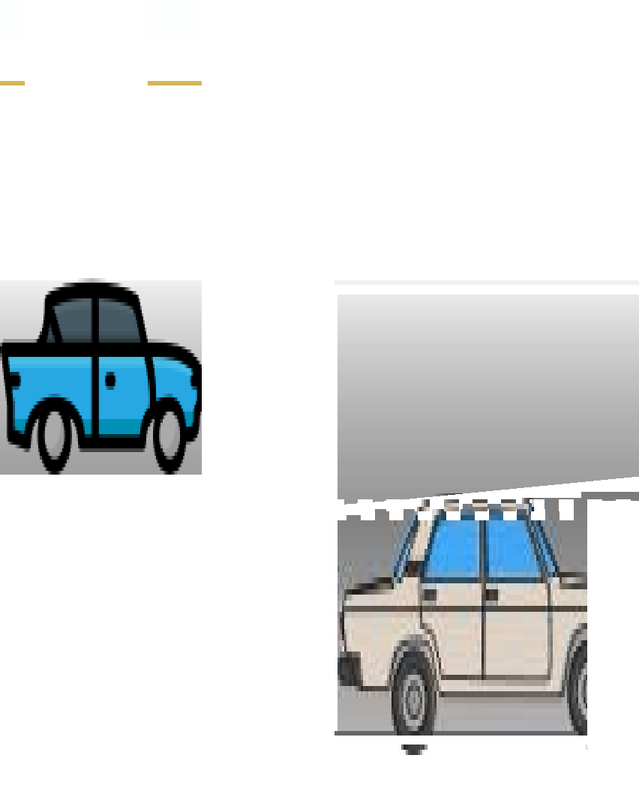






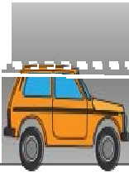


SYSTEM ARCHITECTURE

Slide 10
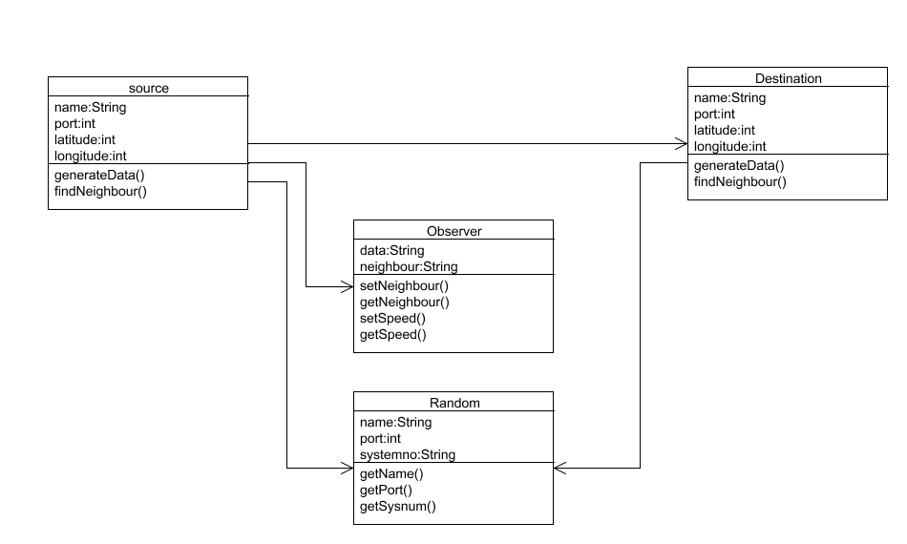
SYSTEMS DIAGRAM CLASS DIAGRAM

Slide 11
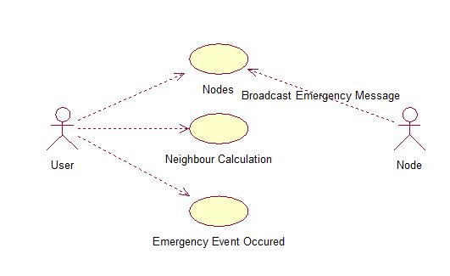
USE CASE DIAGRAM

Slide 12
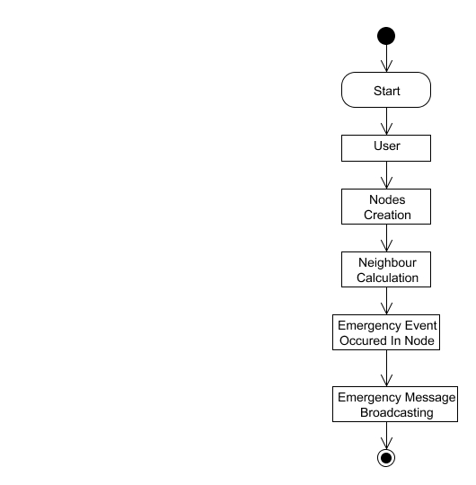
ACTIVITY DIAGRAM

Slide 13
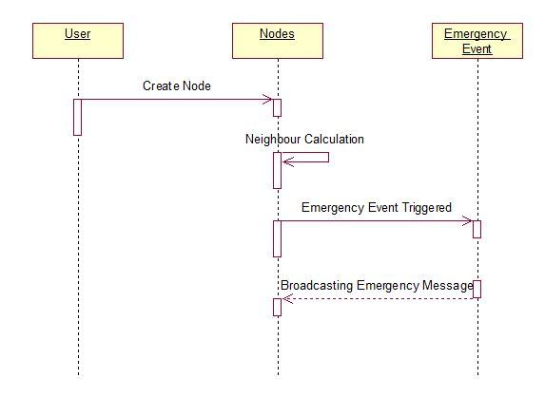
SEQUENCE DIAGRAM

Slide 14
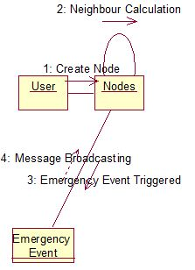
COMMUNICATION DIAGRAM

Slide 15
TECHNOLOGY STACK
SOFTWARE REQUIREMENTS
JDK 1.8
Net beans 8.1
Windows 7
HARDWARE REQUIREMENTS
Hard Disk : 500GB and Above
RAM : 4GB and Above
Processor : I3 and Above
Kit : Arduino with Accelerometer sensor

Slide 16
TECHNOLOGY USED
JAVA
JAVAFX

Slide 17
ALGORITHM
MD5 ALGORITHM is used here.
Message Digest 5 is widely used in hash function producing 128 bit hash value
512 bit input is given as input to the MD5.
64 bits get padded to the original 448 bits to get 512 bits, after padding it receives multiple of 512 bits.
Create MD buffer of 512 bits to store the result of MD5.
512 bits of message enter into MD5 and the output will be in 128 bits.

Slide 18
Project concern:
In order to change the normal word to signature , combination of word and number,
We give the static value of 12345 to MD5 and the final output will be in 128 bits.​
These value get stored in Block chain to reply back to the user.​
Even any of the input the input value changes, whole signature get changed.​
Hence it is efficient to compare values we use MD5 algorithm.​

Slide 19
MODULES
User Registration.
Node creation and Neighbour Calculation
Emergency Event and traffic calculation
Blockchain store

Slide 20
Module 1 : USER REGISTRATION
Every user has to give their basic details in Registration form ,and get sign up in our platform.
So that all the basic details which the user filled are stored in the database, which will be cross checked when we try to sign in .
In Registration form we ask the basic details of their name, Password, contact number and email, finally they need to submit and finish the registration form , so that their information will be stored in database.
During sign in , only user name and password is required.

Slide 21
Module 2 : NODE CREATION AND NEIGHBOUR CLACULATION
In this module, we create a network consisting of nodes. Each node acts as a vehicle and has its own distance and range.
We create nodes by giving latitude and longitude as input which describes the vehicle location.
Each node will be dynamic in position that is changing their position dynamically.
We create ‘n’ number of nodes based on our requirement to form network environment or network formation.

Slide 22
Here we created two RSU , which is used to send the user about the traffic status.
For each vehicle ,we created node, for each vehicle there will be port number, which specifies where the vehicles would be, and we created node by calculating latitude and longitude.
Latitude ranges from 80 to 200, which is X co-ordinate and Longitude ranges from 1000-2000, which is y co-ordinate. These co-ordinates are used to calculate the distance of neighbor.
We created all these nodes in VANET environment, which automatically creates the signal .
For the control of vehicles , we have four arrows. If we click left the vehicle moves left and if we click right , the vehicles moves right, similarly for top and bottom.

Slide 23
Module 3 : EMERGENCY EVENT AND TRAFFIC CALCULATION
If we want to know about the status of particular place, here we set Guindy and Koyambedu in dropdown , we kept any of these values in get traffic update.
First we need to click of request traffic status, then give the place name in traffic update which we want to know.
After we fill the traffic update , the request will be sent to RSU, which will reply back by checking their traffic in received text.
Here we also set the environment of creating the messages of nearby events in received text to the neighbor.
In sender and receiver text field there will be port number, latitude and longitude.

Slide 24
Module 4 : BLOCK CHAIN STORE
Traffic status near by emergency event created in vanet environment will be updated in Block chain .
The informrd stored in block chain in encrypted format using MD5 algorithm.
The information will be decrypted only to the specific user.
Here we set attack if we purposely clicked and proceed the process the message reached neighbor
is of of corrupted, natural events like sudden break etc.. Such eventswill be sent to neighbor
that the sudden brake had occurred in the neighbor node in the received text.

Slide 25
TESTING-Test cases and results
S.NO | ACTION | INPUT | EXPECTED OUTPUT | ACTUAL OUTPUT | RESULTS
1 | Enter username, password and email for registration | Username: Alice Password:ali123 Email: alice12@gmail.com | User registered successfully. | User registered successfully. | Passed
2 | Compare username and password with registered information | Username: Alice Password:ali123 | User login success It redirects to dashboard page. | User login success It redirects to dashboard page. | Passed
3 | Compare username and password with registered information | Username: Alice Password:al12345 | Invalid Username or password | Invalid Username or password | Passed
4 | Locate the vehicle using latitude and longitude coordinates | X coordinate: 100 Y coordinate: 200 | Vehicle should be located | Vehicle is located successfully | Passed

Slide 26
S.NO | ACTION | INPUT | EXPECTED OUTPUT | ACTUAL OUTPUT | RESULT
5 | Locate another vehicle near the first vehicle and check neighbor updation | X coordinate:130 Y coordinate:200 | Vehicle should be located and neighbor should be identified | Vehicle is located and neighbor is identified successfully | Passed
6 | update traffic status at particular location | Click update traffic status button | Response should be updated and broadcasting the message | Response is received and the message is broadcasted to neighbor vehicles. | Passed
7 | Request traffic status by a vehicle | Click request traffic status button | Request is sent to RSU and response is received by vehicle | Request is sent and response is received by the vehicle successfully | Passed
8 | Attack a neighbor vehicle with some fake messages | Click Attack button | Pop up window showing Malicious message | Pop up window showing Malicious message | Passed

Slide 27
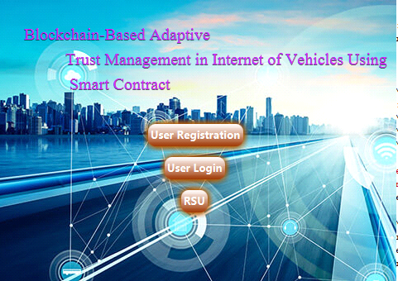
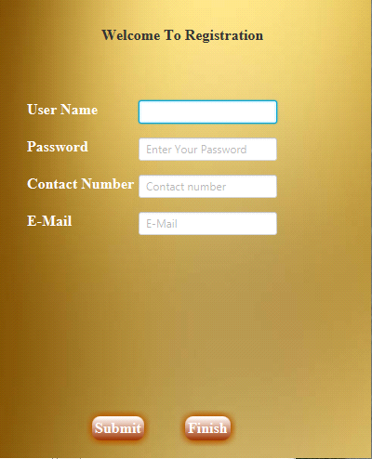
Screenshots

Slide 28
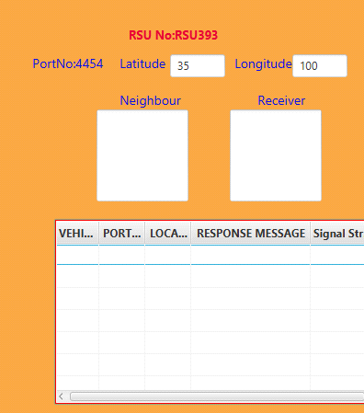
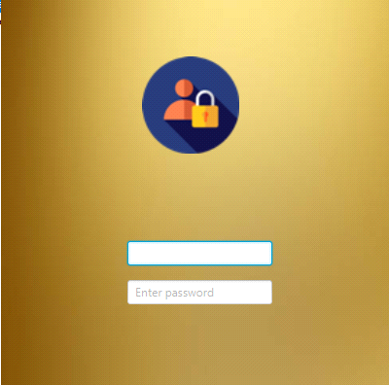
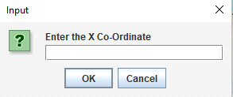
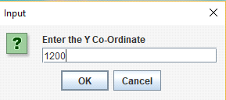

Slide 29
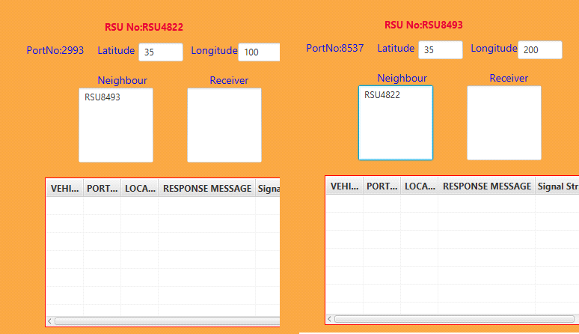
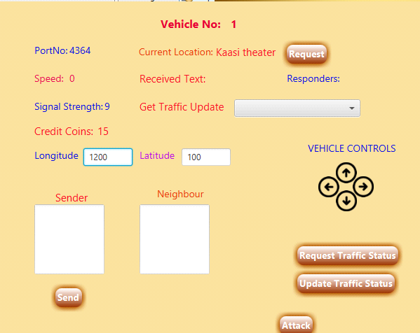

Slide 30

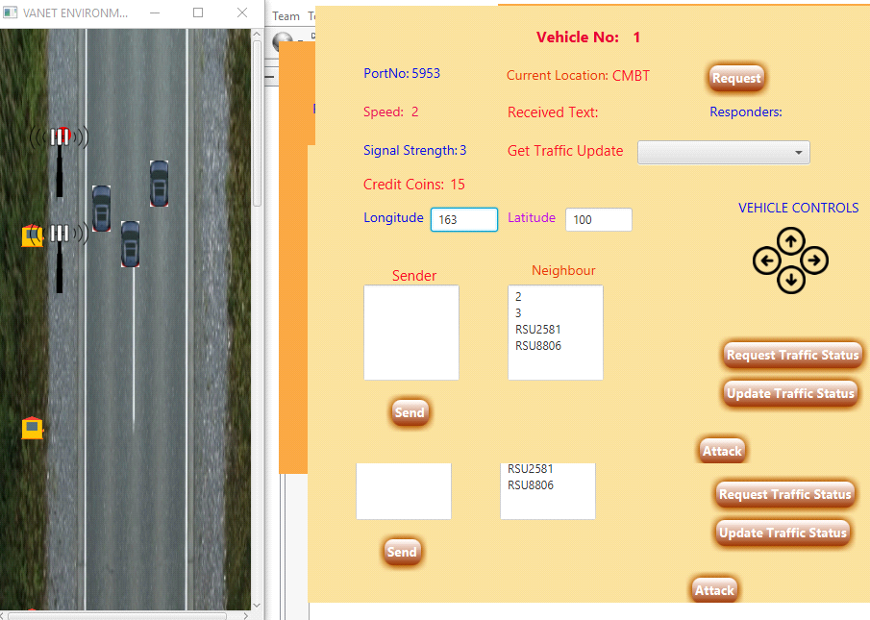

Slide 31
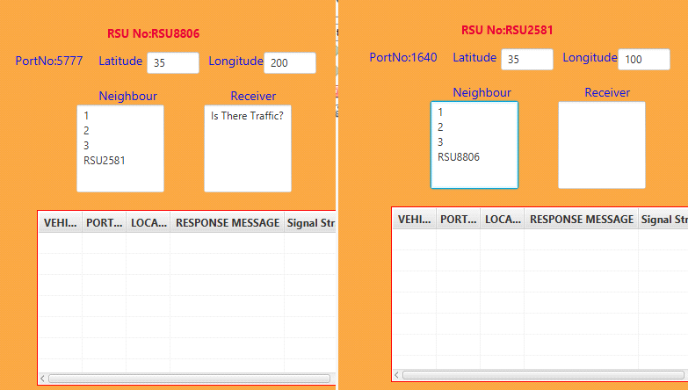
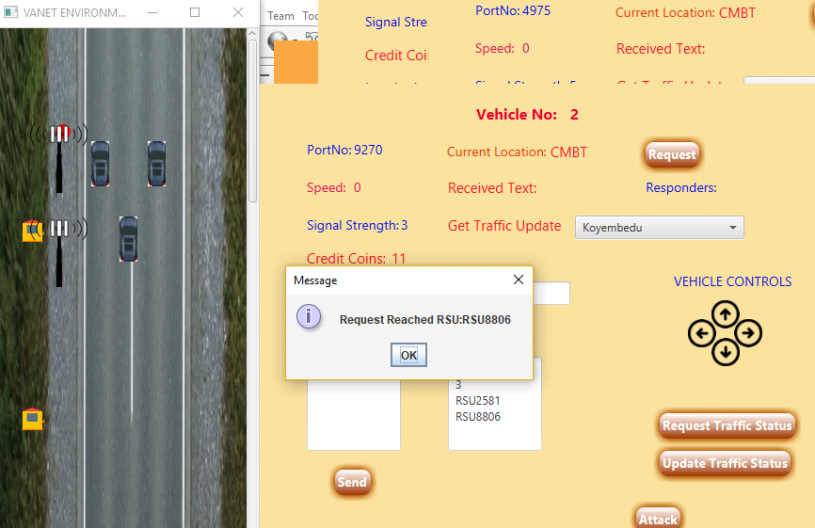
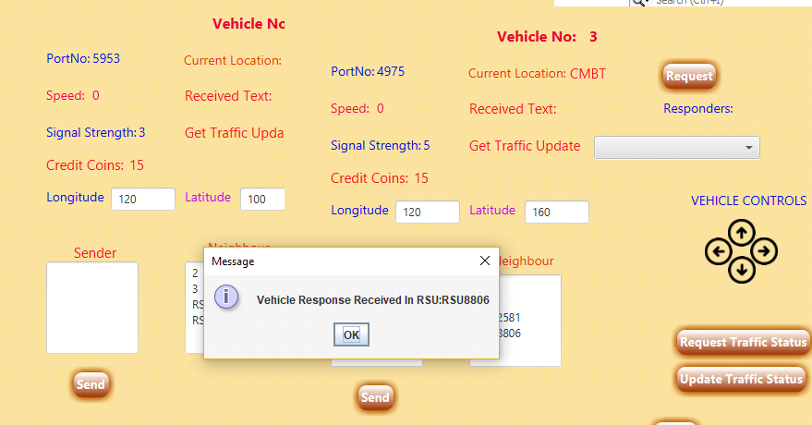

Slide 32
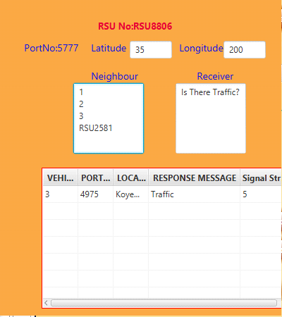
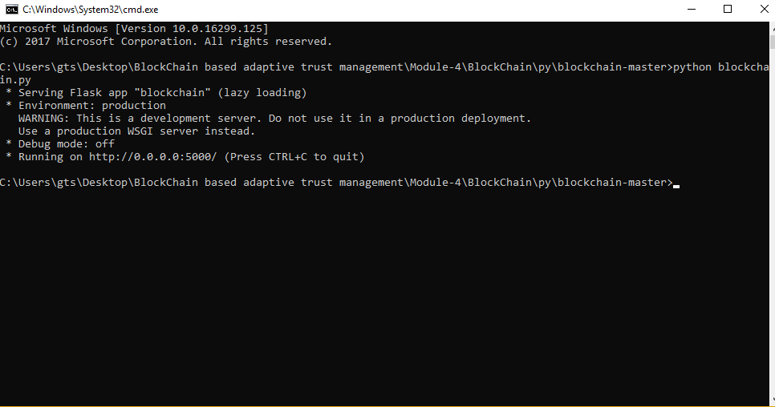

Slide 33
REFERENCES
J. Kamel, F. Haidar, I. B. Jemaa, A. Kaiser, B. Lonc, and P. Urien, “A misbehavior authority system for Sybil attack detection in C-ITS,” in Proc. IEEE 10th Annu. Ubiquitous Comput., Electron. Mobile Commun. Conf. (UEMCON), New York, NY, USA, 2019.
P. K. Singh, S. K. Nandi, and S. Nandi, “A tutorial survey on vehicular communication state of the art, and future research directions,” Veh. Commun., vol. 18, Aug. 2019, Art. no. 100164.
H. D. Abdulkarim and H. Sarhang, “Normalizing RSS values of Wi-Fi access points to improve an integrated indoors smartphone positioning solutions,” in Proc. Int. Eng. Conf. (IEC), Jun. 2019, pp. 171–176.
K. Z. Ghafoor, M. Guizani, L. Kong, H. S. Maghdid, and K. F. Jasim, “Enabling efficient coexistence of DSRC and C-V2X in vehicular networks,” IEEE Wireless Commun., vol. 27, no. 2, pp. 134–140, Apr. 2020.
J. Huang, L. Kong, G. Chen, M.-Y. Wu, X. Liu, and P. Zeng, “Towards secure industrial IoT: Blockchain system with credit-based consensus mechanism,” IEEE Trans. Ind. Informat., vol. 15, no. 6, pp. 3680–3689, Jun. 2019.J. Huang et al., “Blockchain based mobile crowd sensing in industrial systems,” IEEE Trans. Ind. Informat., published, Jan. 3, 2020,
N. Torabi and B. S. Ghahfarokhi, “Survey of medium access control schemes for inter-vehicle communications,” Comput. Elect. Eng., vol. 64, pp. 450–472, Nov. 2017.

Slide 34
REFERENCES
R. Bauza and J. Gozálvez, “Traffic congestion detection in large-scale scenarios using vehicle-to-vehicle communications,” J. Netw. Comput. Appl., vol. 36, no. 5, pp. 1295–1307, 2013.
A. Aliedani and S. W. Loke, “Cooperative car parking using vehicle-to-vehicle communication: An agent-based analysis,” Comput. Environ. Urban Syst., Jun. 2018. [Online]. Available: https://doi.org/10.1016/j.compenvurbsys.2018.06.002
A. Fernández-Isabel and R. Fuentes-Fernández, “Analysis of intelligent transportation systems using model-driven simulations,” Sensors, vol. 15, no. 6, pp. 14116–14141, 2015.
S. Harrabi, I. B. Jaafar, and K. Ghedira, “A novel clustering algorithm based on agent technology for VANET,” Netw. Protocols Algorithms, vol. 8, no. 2, pp. 1–19, 2016.
K. Grover, A. Lim, S. Lee, and Q. Yang, “Privacy-enabled probabilistic verification in broadcast authentication for vehicular networks,” Ad Hoc Sensor Wireless Netw., vol. 32, nos. 3–4, pp. 239–274, 2016

Slide 35
PUBLICATIONS
[1] HARINI S, AROCKIA SNEHA A, KAVIYA B, VIJAYALAKSHMI C, "BLOCKCHAIN BASED ADAPTIVE TRUST MANAGEMENT IN INTERNET OF VEHICLES USING SMART CONTRACT", International Journal of Creative Research Thoughts (IJCRT), ISSN:2320-2882, Volume.9, Issue 6, pp.b529-b532, June 2021, Available at: http://www.ijcrt.org/papers/IJCRT2106192.pdf

Slide 36
Thank you

